Slide 1
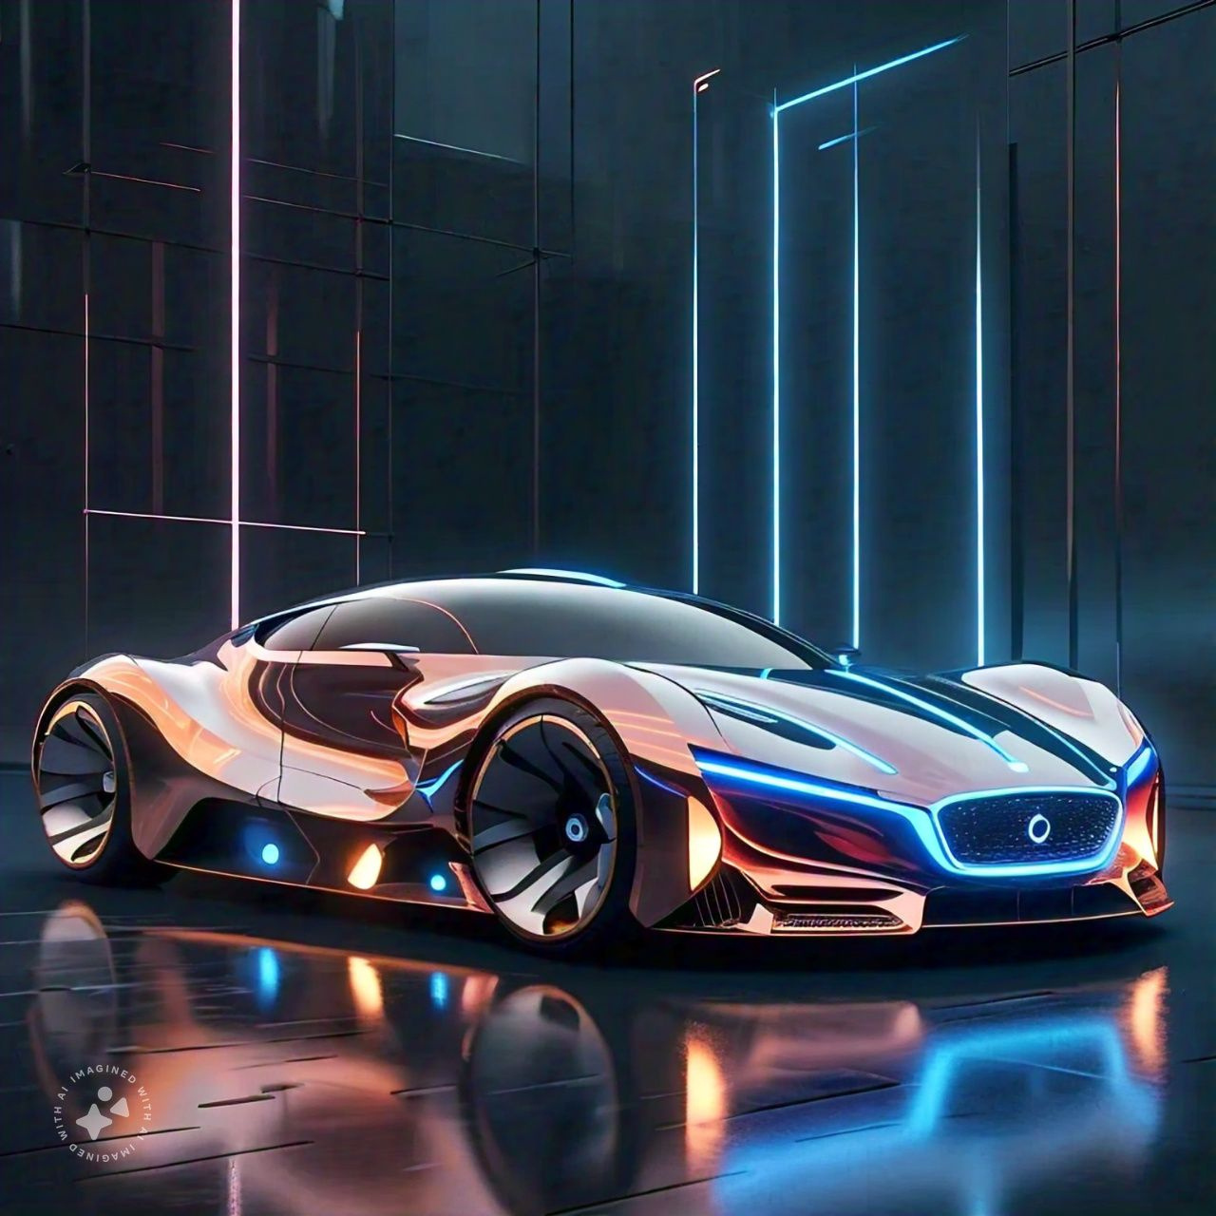
the ss600

Slide 2
the ss600
The Simply Silent 600, also referred to as the SS600, is a significantly modified Aptera-inspired vehicle. With solar power, this car can travel 60 kilometers per day. Additionally, it has a 600-kilometer range between charges. This three-seater car will cost you about 13 lakhs. In order to prevent aerodynamic drag, it has both an integrated and a deployable solar panel that will only activate when the vehicle is at rest. An EV charging station is not necessary to charge this transportable solar panel.

Slide 3
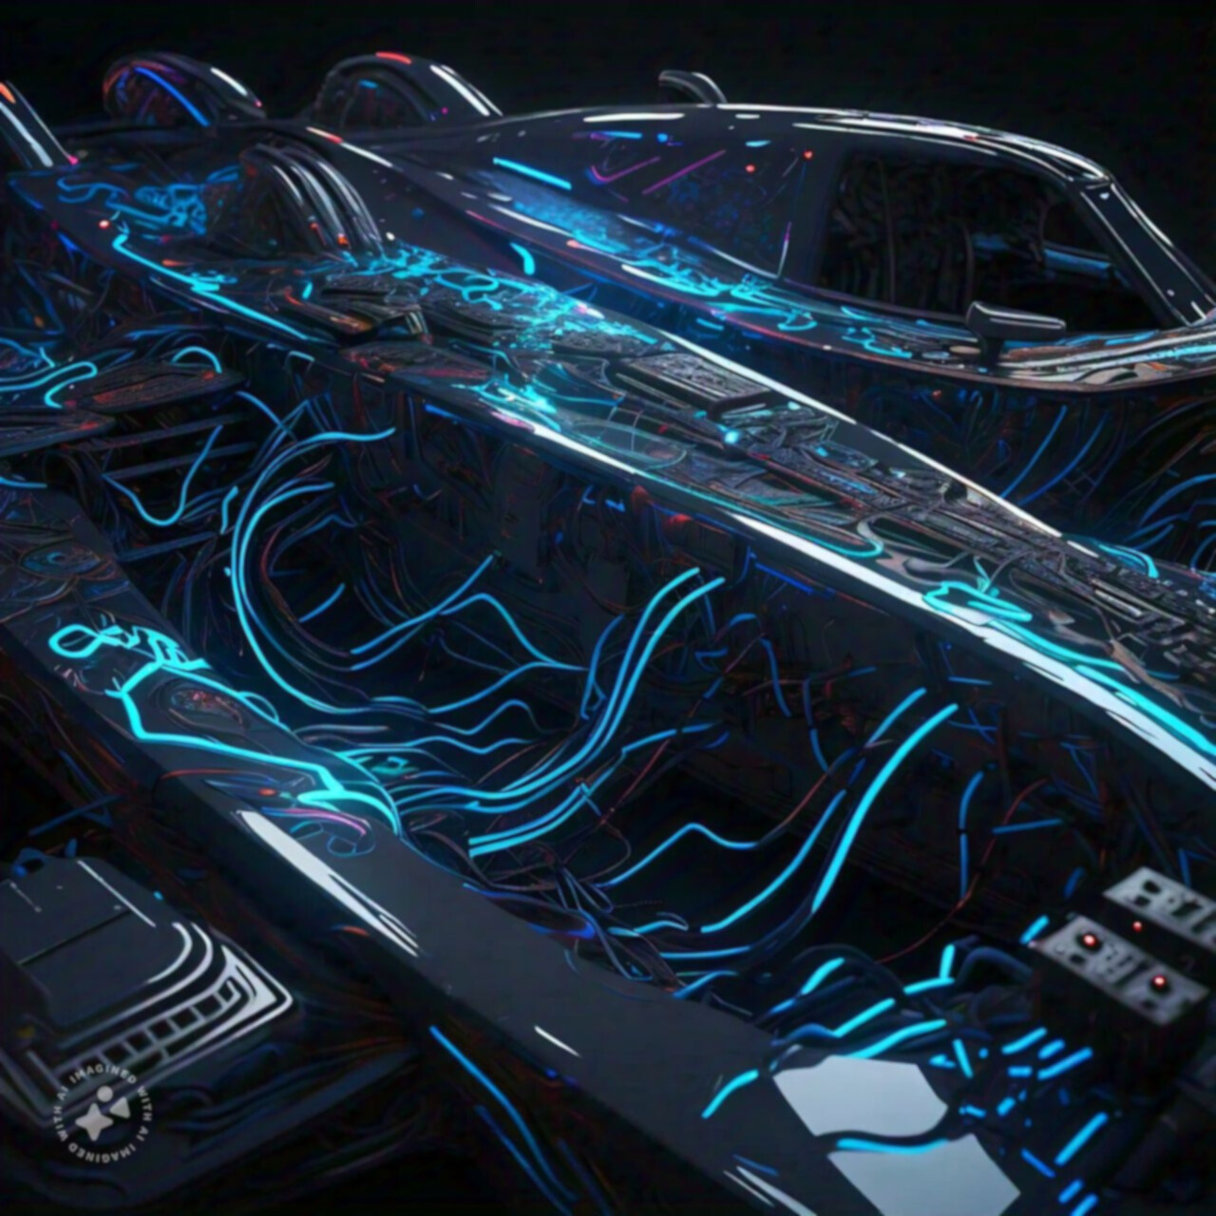
the vision behind the mission
By being the top supplier of environmentally friendly electric cars (EVs) that blend performance, cutting-edge technology, and environmental stewardship, we hope to transform the automotive sector and contribute to a cleaner, greener future.
Our goal is to create, produce, and sell EVs that put sustainability, affordability, and innovation first so that customers can choose environmentally friendly options without sacrificing performance or quality.

Slide 4
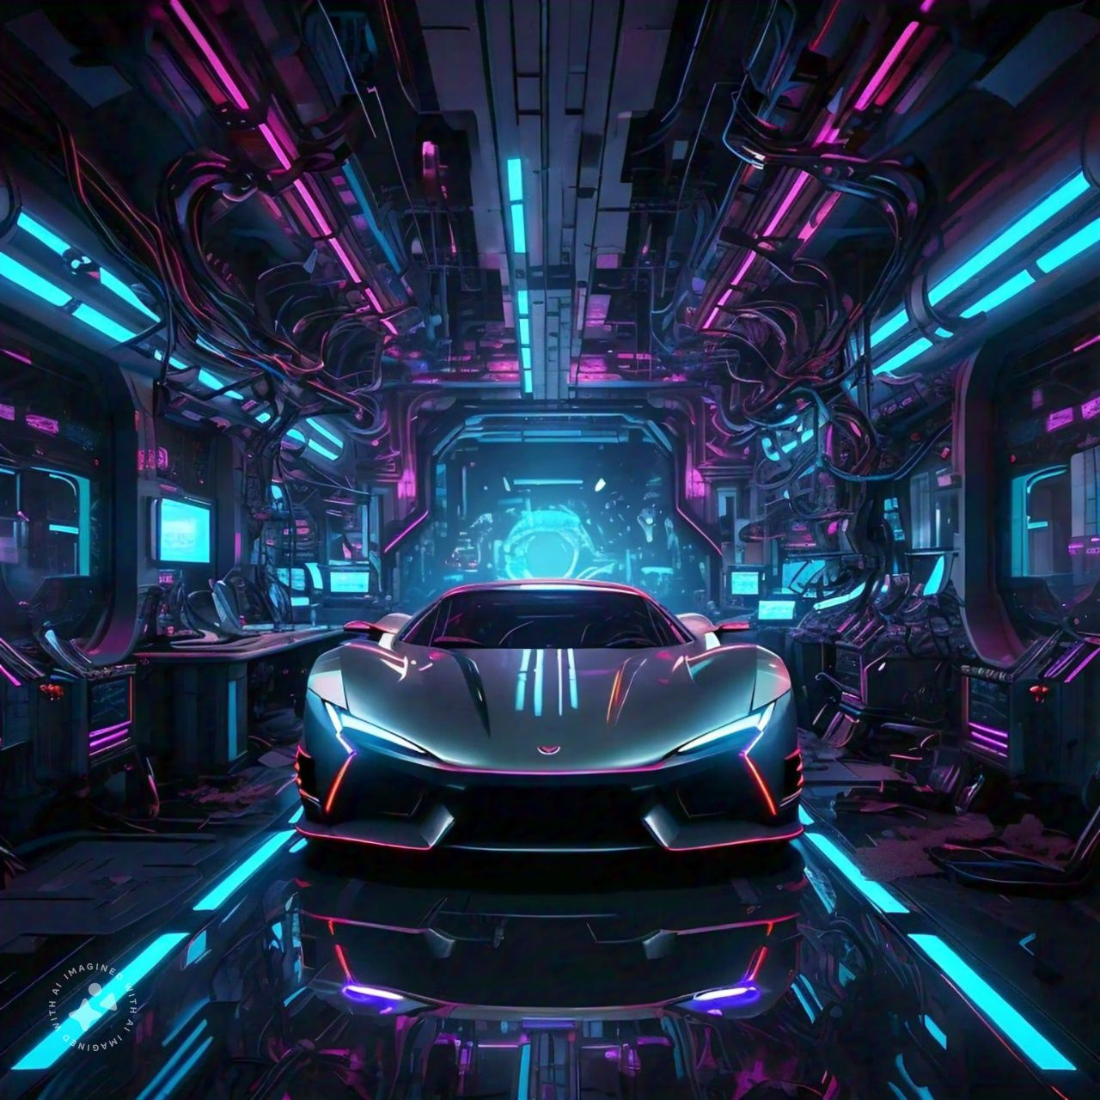
Market analysis
Target Market
Market Trends
Eco-Conscious Consumers
Urban Commuters
Families
Commercial Fleets
Regulatory Support
Growing EV Adoption
Technological
Advancements

Slide 5
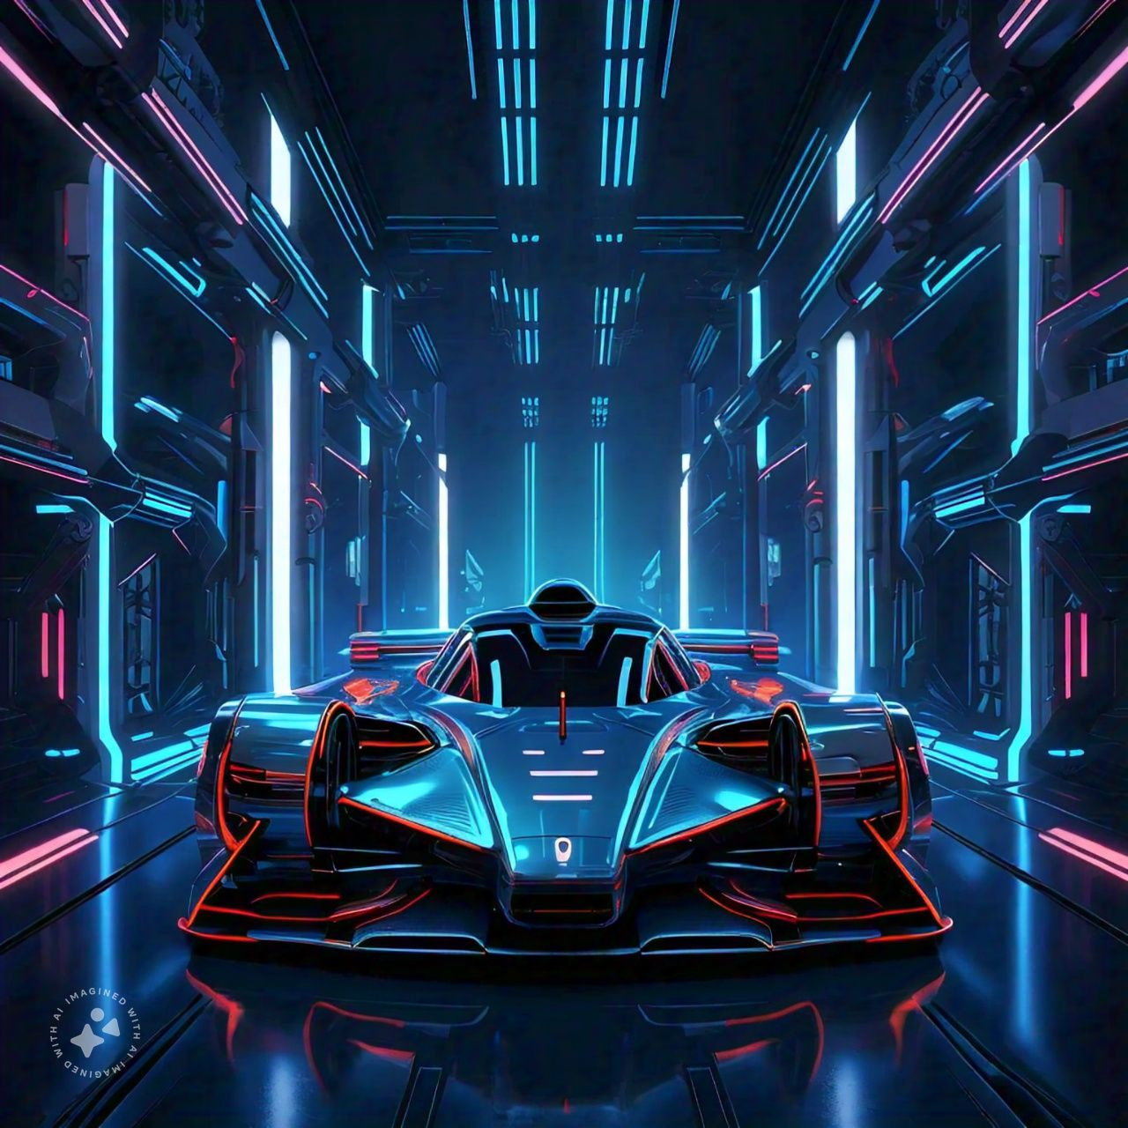
marketing
BRAND POSITIONING:
Establish the brand as a leader in sustainability and innovation, emphasizing transparency in sourcing and manufacturing processes.
PROMOTION:
Utilize social media campaigns highlighting sustainability stories. Partner with environmental organizations and the government for co-branding opportunities and promotion. Engage in community events and sponsorships to promote electric mobility.
SALES CHANNELS:
Direct-to-consumer sales model to enhance customer engagement and lower costs. Collaborate with dealerships that align with the brand's sustainability values.

Slide 6

supply chain
Manufacturing
Sourcing
Implement lean principles to minimize waste and improve efficiency.
Utilize automation and IoT technologies to enhance production processes and data analytics.
EOL Management
Partner with suppliers who prioritize sustainability, ensuring that raw materials are ethically sourced. Aim for localized supply chains to reduce transportation emissions and support local economies.
Create a program to facilitate the return and recycling of vehicles at the end of their life cycle.
Develop strategies for reusing parts and materials to create a closed-loop system.

Slide 7

Financial plans
The company will seek funding from venture capitalists in green technology and sustainable investments and government grants to promote electric vehicle development. The costs will be managed through a detailed budget, continuously assessing operations for cost-saving opportunities. Revenue streams include vehicle sales, maintenance packages, and software subscriptions. It will also explore partnerships with tech companies for additional features and services.

Slide 8

long term goals
The company aims to penetrate the growing EV market by setting sales targets for the first five years, continuously expanding its product lineup based on customer feedback and market trends, and exploring opportunities for global expansion into international markets with favorable policies and charging infrastructure. They will also tailor their products and marketing strategies to meet regional needs and pursue industry certifications and awards for sustainability and innovation.

Slide 9
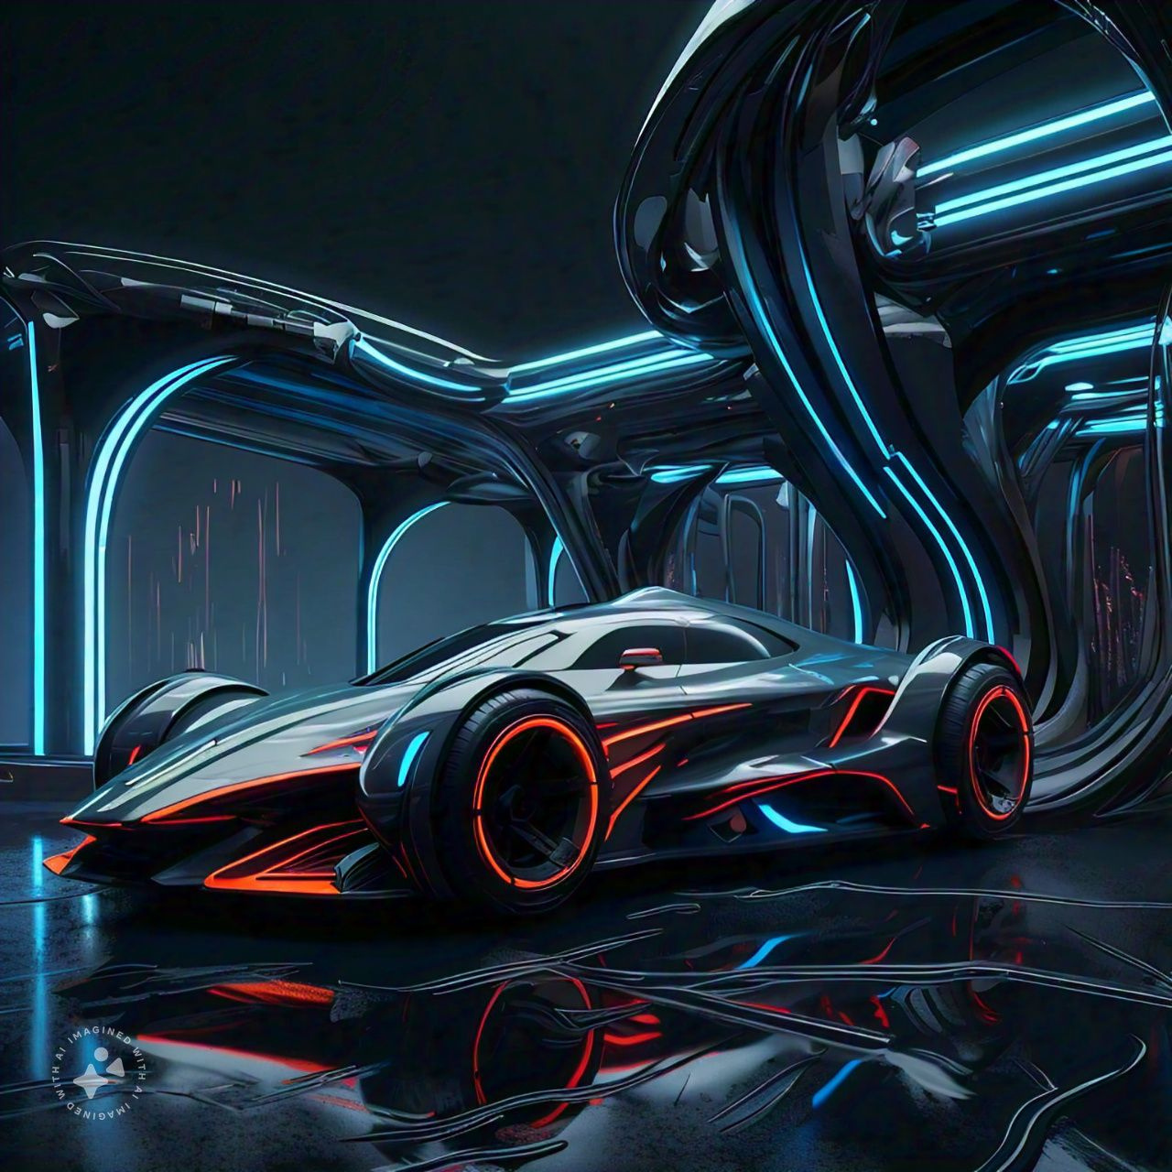

thank you

